Slide 1

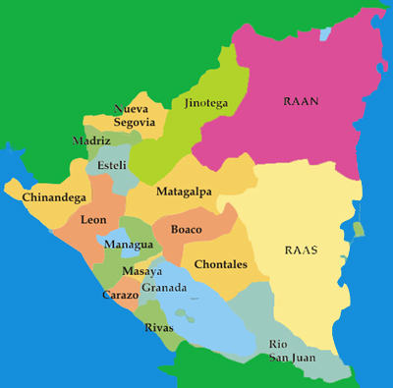
Clustering analysis
Neighborhoods in Nicaragua

Slide 2
Introduction
The objective of our project is to carry out a clustering of the different neighborhoods of Nicaragua based on the types of businesses and places of recreation found in each of the neighborhoods.

Slide 3


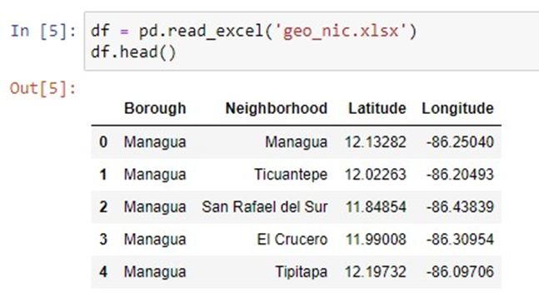


Data
We build a database that contains all the departments of Nicaragua with each of its neighborhoods, in each of the neighborhood we will locate their respective latitude and longitude.

Slide 4
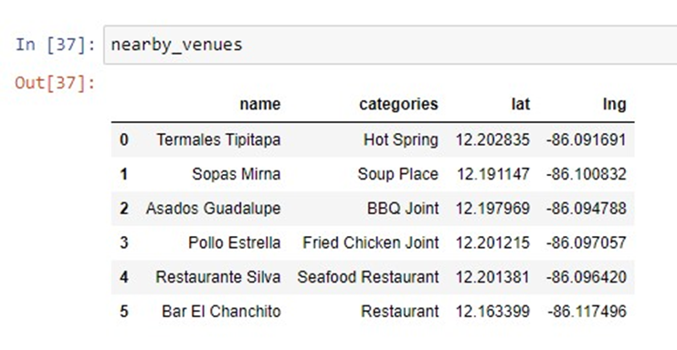
Data
We compile business and leisure data for each neighborhoods in Nicaragua, we will use the data provided by Foursquare.

Slide 5
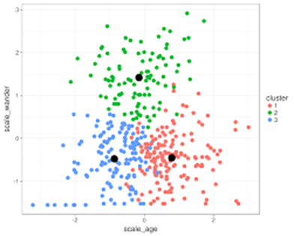
Methodology
Cluster analysis
Elbow Method
K-means

Slide 6
Results

Slide 7
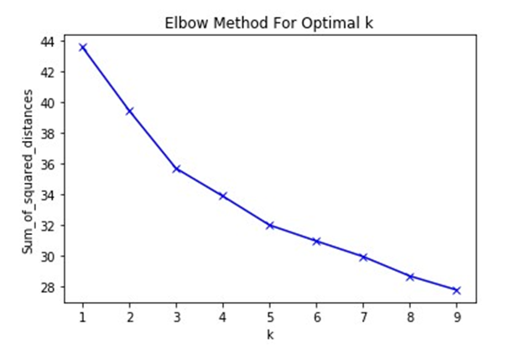
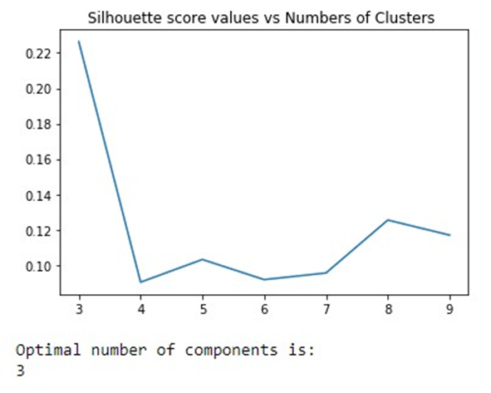
Elbow method

Slide 8
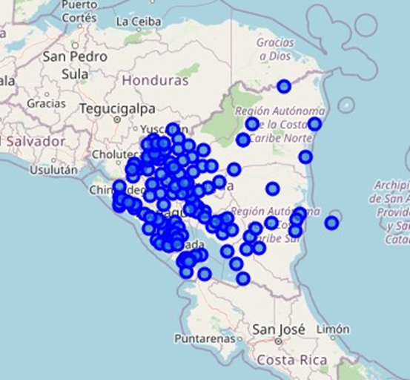
Map of Nicaragua

Slide 9
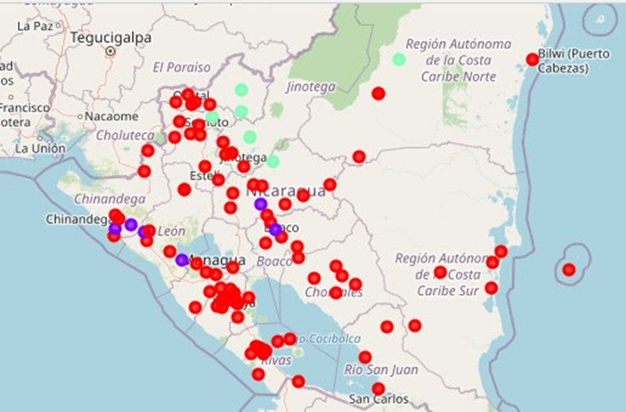
Clusters in the map

Slide 10
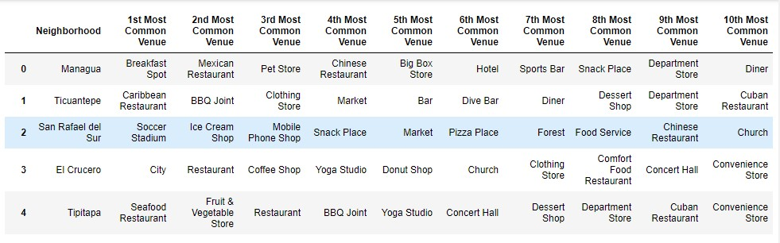
Cluster 1

Slide 11
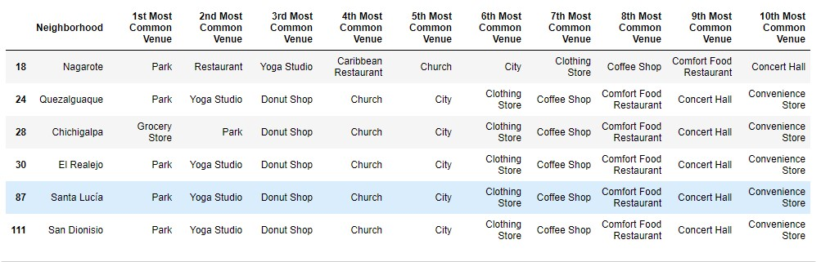
Cluster 2

Slide 12
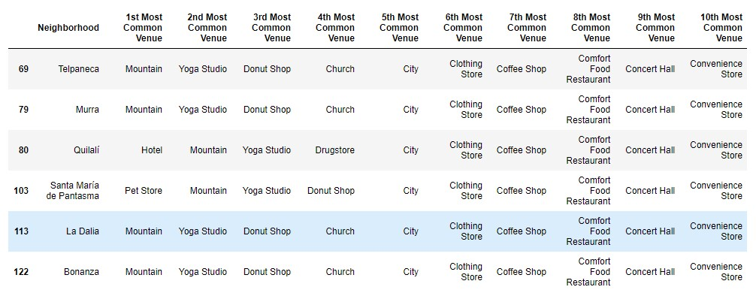
Cluster 3

Slide 13
Conclusion
In this work we carry out a cluster analysis on the different neighborhoods of Nicaragua based on the different businesses and leisure places present in each neighborhood. The data of the different businesses in each neighborhood were extracted from the Foursquare database.
This analysis was performed in 139 neighborhoods in Nicaragua, and clustered with the K-means algorithm. We performed the Elbow method and determined that the optimal number was 3 clusters.
In the first cluster we find 89 neighborhoods where we find mostly hotels and restaurants. In the second cluster we have 6 neighborhoods in which we find small towns with churches and Parks. Finally, in the last cluster we find 6 neighborhoods wuth mountainous areas, churches and yoga studios.

